Slide 1
Preston Photographic Society 2020-2021
Introduction To
Notes:
Thankyou for coming to our meeting tonight and allowing us to introduce Preston Photographic Society
I am…..

Slide 2
A Brief history
Preston Camera Club was founded on the 14th November 1905.
The original members were from the Preston Scientific Society who wanted a society for photography. Professional and amateur photographers were attracted to the club which held lectures, competitions and events with the aim of promoting photography. For over half a century the Club met at Stanley Chambers on Lancaster Road. During this time the club took part in regional and national competitions where it became known for its natural history and portrait photography. Some members achieving notoriety; natural history photographer Joseph Speed, who was the first to capture the flight of a bumble bee at 1/5000th of a second, the photo-journalist Noel Combes and art photographer Jack Nicholson.
Preston Photographic Society as it is now known, is a member of the Lancashire and Cheshire Photographic Union (L&CPU), which is turn in a member of the Photographic Alliance of Great Britain (PAGB). We have about 72 members ranging in age from 24 to 70 covering the full range of abilities from beginners to professional photographers.
Notes:
PPS is 115 years old! It was formed on 14 Nov 1905 by members of the Preston Scientific Soc who wanted a camera club.
These were amateurs and professional photographers who met at Stanley Chambers on Lancaster Rd.
In competitions PCC became noted for natural history and portrait photography. Some members achieving notoriety:
Joseph Speed – 1/5000th sec flight of a bumble bee
Noel Combes – Photo Journalist
Jack Nicholson – Art Photography
PPS is part of the Lancashire & Cheshire Photo Union and Photographic Alliance of GB
We have about 72 members who range in age from 24 to 70 and from absolute beginners to professional photographers

Slide 3
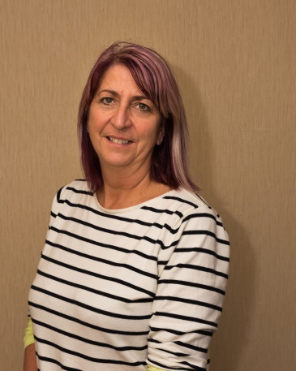
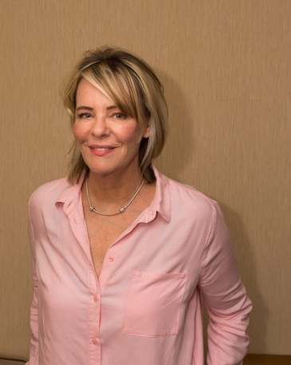
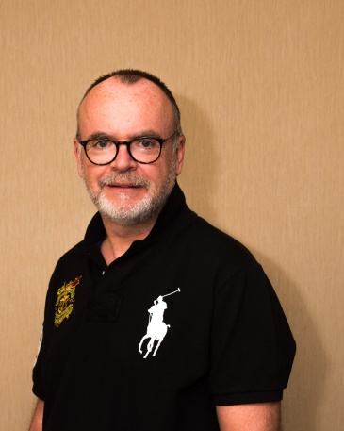
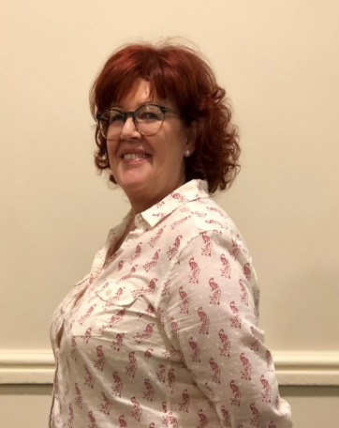
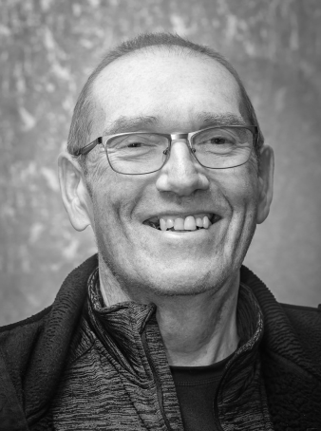
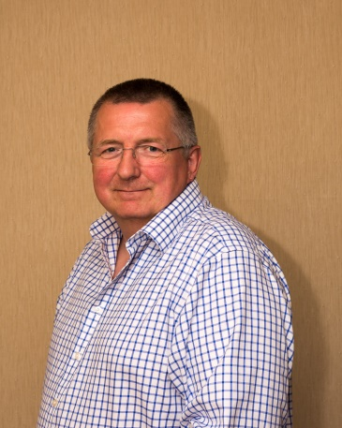
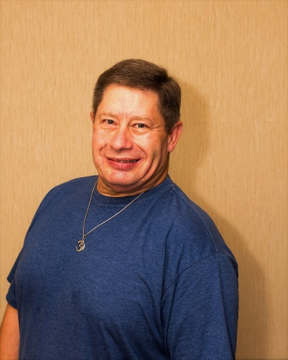
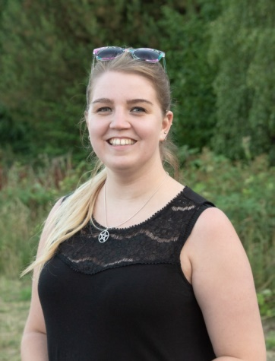
Who’s who.…The PPS Committee
Louise Ollerton
Exhibition and Social Secretary
Tim Gilbert
External Competition Secretary
Carol Main
Syllabus Secretary
Iain Jack PPS Secretary
Michael Porter
Treasurer and VP
Dave Duxbury Internal Competition Secretary
Lee Inskip-Clark Photo walks Coordinator
Charlotte Whittle Media Secretary
TBD PPS President
Notes:
This is the Committee…….it’s all their fault!!

Slide 4
So what do we do?
We take Pictures and have Fun!!
We Meet On A Thursday Evening During The Season (Sept 20 – May 21)
Usually at Moor Park Sports and Social Club (was Fulwood Conservative Club). But due to Covid-19 we are holding our meetings online using Zoom until we are able to resume. Our syllabus is structured to cater for a wide variety of photographic interests and includes:-
Lectures by experts in a diverse range of photographic fields,
Practical demonstrations of techniques (Members Nights),
Photo-walks,
Competition nights and Inter-club events,
Photo-opportunities: Preston City Council (Guildhall/Preston Live), Winckley Square etc
Critique nights,
Occasional Big Speaker Events (Famous Photographers),
Social Activities and a monthly raffle on competition nights.
Where can I find out what is going on at the club?
We are on Facebook, we have a PPS web-site (prestonphotographicsociety.org) and issue a Weekly Newsletter to members.
Notes:
PPS usually meets at Moore Park Sports & Social Club every Thursday at 7:30pm.
At the moment we are holding meetings online using the Zoom application.
Our syllabus caters for all interests.
We still have lectures, practical demonstrations and competitions, but now Photo-walks, Critique nights, big speaker events every two years and social events.
You can follow us on Facebook and on the PPS Webpage.

Slide 5
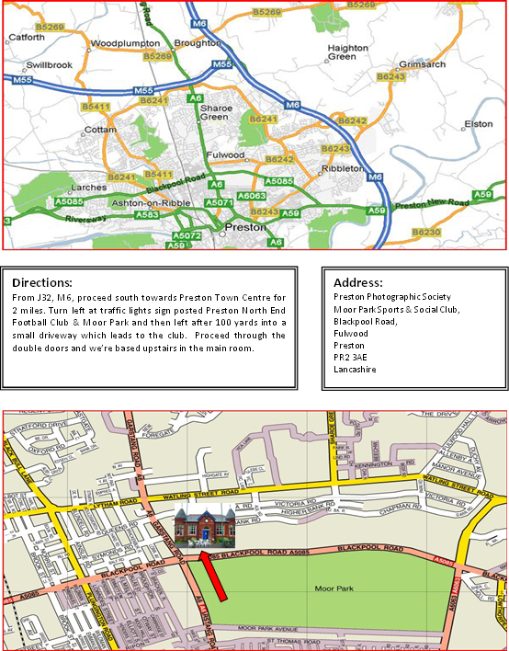
Where Are We
Please Note: If you are using a Tom Tom / sat nav to find us, it may direct you incorrectly at the traffic lights nearest to the club at the junction of Blackpool Road and Garstang Road. If coming from J32 on the M6, it may direct you right at the lights instead of left.
Or
On Zoom joining instructions will be emailed to new members
Notes:
Please take note of our location and heed the warning regarding Tom-Tom Sat Navs

Slide 6
Our Lectures
10th September 2020 Oliver Wright A year in pictures
29th October 2020 Gary Peltz Scapes of land city and everything inbetween
26th November 2019 David Keep A project approach to photography
14th Jan 2021 Leigh Preston 5 Essays (Thematic)
21st Jan 2021 Mark Gilligan In his element
28th Jan 2021 Tesni Ward Working with wildlife
11th Feb 2021 Margaret Soyara Healing photography
25th Feb 2021 Justine Garner HDR Techniques
18th Mar 2021 Paul Statter Soul to soul (street and creative photography)
25th Mar 2021 Phil Garlington Commercial to street
22nd Apr 2021 Bernard O’Sullivan Corporate Photography
6th May 2021 Ashley Franklin The wider world of photography
Notes:
This shows the very diverse lecture programme of speakers. From ‘Aurora’ to ‘ ?? ’

Slide 7
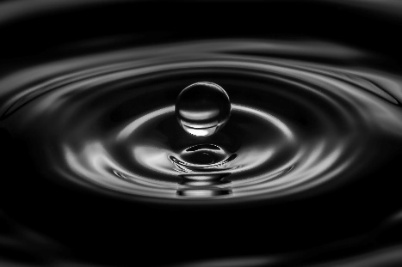
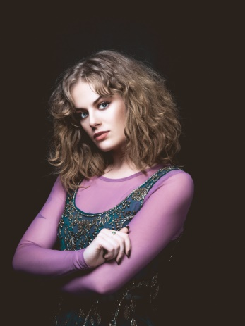
Members Nights & Portrait Evenings
We have 2 Members Nights planed this season on: 15th October 20 and 18th February 21
There are 6 Portrait evenings planed this season which are held on a Thurs / Tues evening : 17th October / 22nd October / 19th November / 26th January 21 / 23rd February 21 / 23rd March 21
These usually have a fee of £10 per person to attend, which pays for the models, room hire and provides:
Help on studio lighting / Off camera flash
Model direction and other techniques
Places are limited to 6 people to give everyone time
You will come away with some nice images!
There are also a couple of critique nights planned . These may be run over Zoom or at the club if restrictions are relaxed. These are : 8th October / 16th February 21 /
Iain Jack
Wioletta Maj
Notes:
Members Nights are aimed at learning, practicing techniques eg Capturing water drops, Light/Star trails, Night Photography etc.
We also have portrait nights using models eg Izzy here, Steam Punk and Knights in Shining Armour. Members experience shooting in a studio environment and learning to use lighting equipment.
Places are limited on Portrait nights to allow people enough time. I promise you will get some great images.

Slide 8
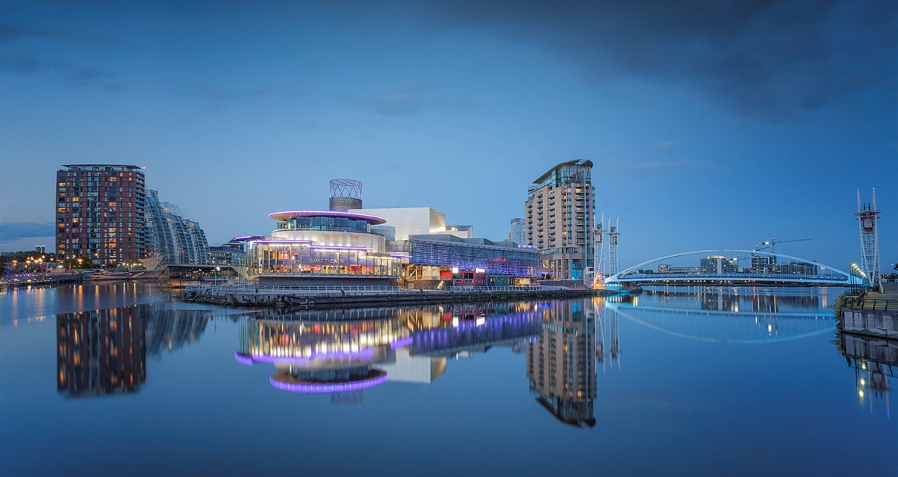
Our Photo-Walks
Photo-walks occur throughout the summer and winter months, outside of the club’s normal season and are open to anyone (including non members). Below are some of the typical photo-walk destinations :
Brock bottoms Skipool Creek Albert Dock, Liverpool Fleetwood Wrecks / Mary’s Shell Anthony Gormley’s Another Place, Crosby Abbey Ruins, Heysham Fairy Glen, Parbold St Annes Pier / Beach Huts Salford Quays, Manchester Avenham & Miller Parks
All finished off with a visit to a local pub!
Media City, Pam Guy
Notes:
These past photowalks give you an idea of some of the places we go out of season. Photowalks are open to anyone including non-members.
These are also opportunities to learn from other photographers and socialise too!
These events are advertised on Facebook / PPS Website and by emailed newsletter for members.
These events take you to places you may not know exist and find some great pubs!

Slide 9
Our Competitions
External Competitions (contact Tim Gilbert, external competition secretary)
3 Way battle with Chorley, Leyland and Preston
L&CPU and ICPA Competitions
International, inter-club competition – Melbourne Trophy
Matching Image Competition with Blackburn and Burnley
Internal Monthly Competitions are judged by experienced external judges (contact Dave Duxbury, internal competition secretary)
Prints categories
Fox Talbot (traditional chemically processed)
Prints Colour & Monochrome
Projected Digital Images (PDI) categories
Novice / Theme / Flora & Fauna / Advanced
Annual competitions: Opening Night, 3 on a theme competition, Print and PDI Image of the year competition
Notes:
We compete in External (regional / national / international) and Internal Competitions.
These are optional, some people find them too time consuming / demanding.
Internal Competitions are held monthly and comprise
Prints : Fox Talbot monochrome images (chemically processed) and Mono/Colour prints (show examples)
PDI : Novices, Themes, Flora & Fauna and Advanced you saw some of these images at the start of the evening.
We also hold a competition between Preston UK and Preston Australia!

Slide 10
Monthly Internal Competitions
Fox Talbot Open to all members Focused on the traditional Black and White film processing and printing. Any entry MUST be fully developed and printed by yourself. | Open Monochrome Prints Open to all members. Images must be printed either by yourself or by a printing company. Images may be either Black and White or of a single colour tone. | Open Colour Prints Open to all members. Images may be printed either by yourself or by a company. Images should be colour.
Open Projected Digital Image Images can be any subject, genre or style. Novice - For members who are new to photography / inexperienced. Or Advanced – Experienced members. Images can be from any genre and style. Images taken and digitally processed by yourself and submitted as a .jpg file. | Theme – Projected Digital Image Open to all members. Submitted images should be an interpretation of the Monthly Theme eg circles, footwear, family. Images taken and digitally processed by yourself and submitted as a .jpg file. | Flora & Fauna Projected Digital Image Open to all members. Submitted images should comply with the Annex to the PPS competition rules. In particular, it should be noted that digital manipulation is quite limited. Read the rules if you wish to enter. Images taken and digitally processed by yourself and submitted as a .jpg file.
Notes:
Just pick out the key points for each category.

Slide 11
Competition Themes 2020 - 21
1st Monthly (01 October) - Trees
2nd Monthly (05 November) - Messing about on the river
3rd Monthly (03 December) - Culture
4th Monthly (07 January 21) - Domestic Goddess
5th Monthly (04 February 21) - The Garden
6th Monthly (11 March 21) - My Love
7th Monthly (15 April 21) - Sculpture
Notes:
These are the Monthly Competition themes this season
What picture would you take for ‘Culture’? Any ideas I’m struggling!
Or something a bit easier ‘My Love’? (Chocolate, cakes, wife, )

Slide 12
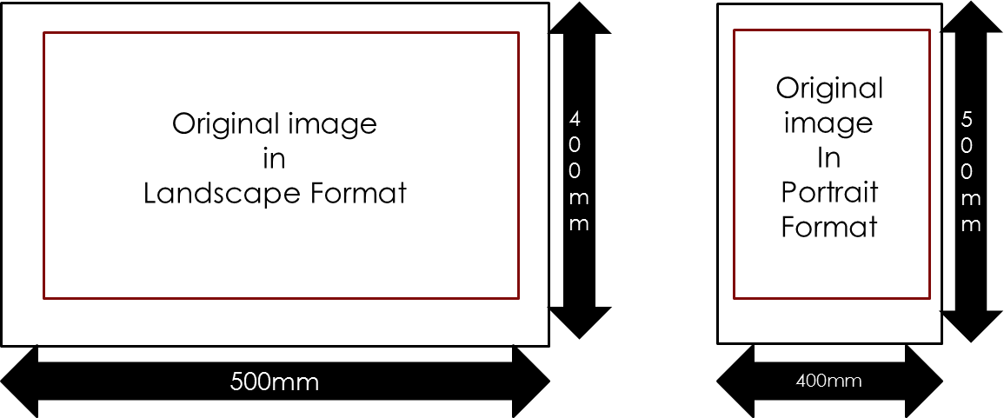
Editing and Sizing for Competitions
Why enter competitions? Feedback on your images will help you improve your photography.
So what exactly are you allowed to do to an image with regards to editing? Anything, except in Flora & Fauna (see PPS competition rules)
Edit using Lightroom, Photoshop, Elements etc.
PDI Image size is 1600 x 1200 pixels, saved as jpg’s. 1200 pixels is the maximum height of any image
Prints must be 50cm x 40cm and submitted on a mount which must not be thicker than 4mm.
Fox Talbot prints should also be mounted and must not exceed 16 x 20 Inches.
Notes:
Show how to export an image (landscape or portrait) from Lightroom…
Show some examples of prints….

Slide 13
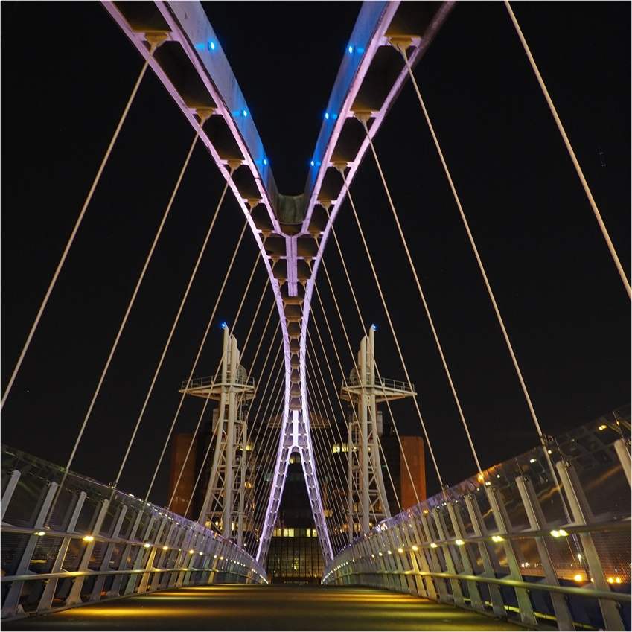
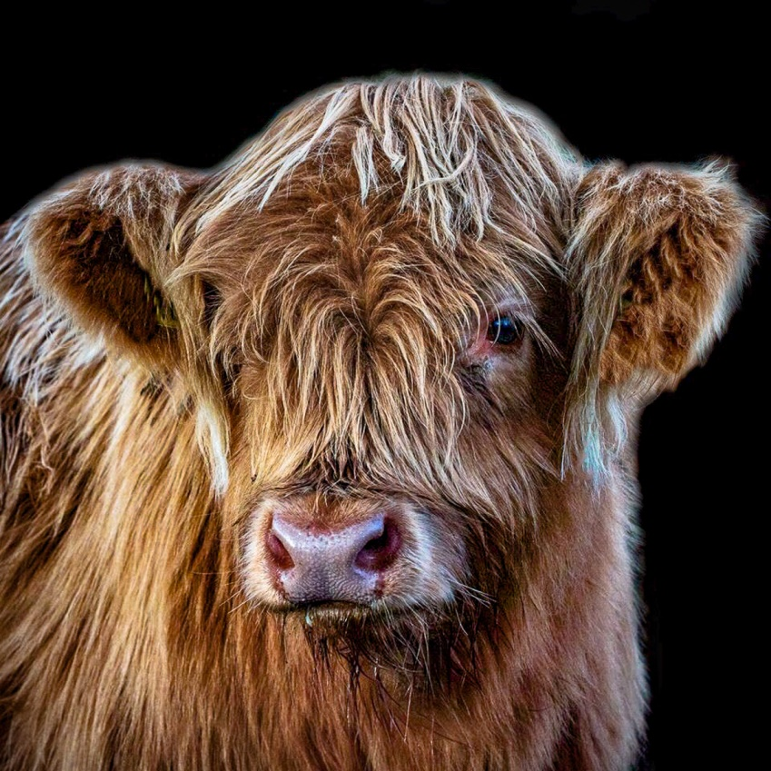
Some Images from Previous years There are typically 700 images entered throughout all competitions.
Novice Category
Millennium Bridge
Louise Ollerton
Highland Cow Paul Yates
Notes:
These are some images from last season. These were beginners!

Slide 14
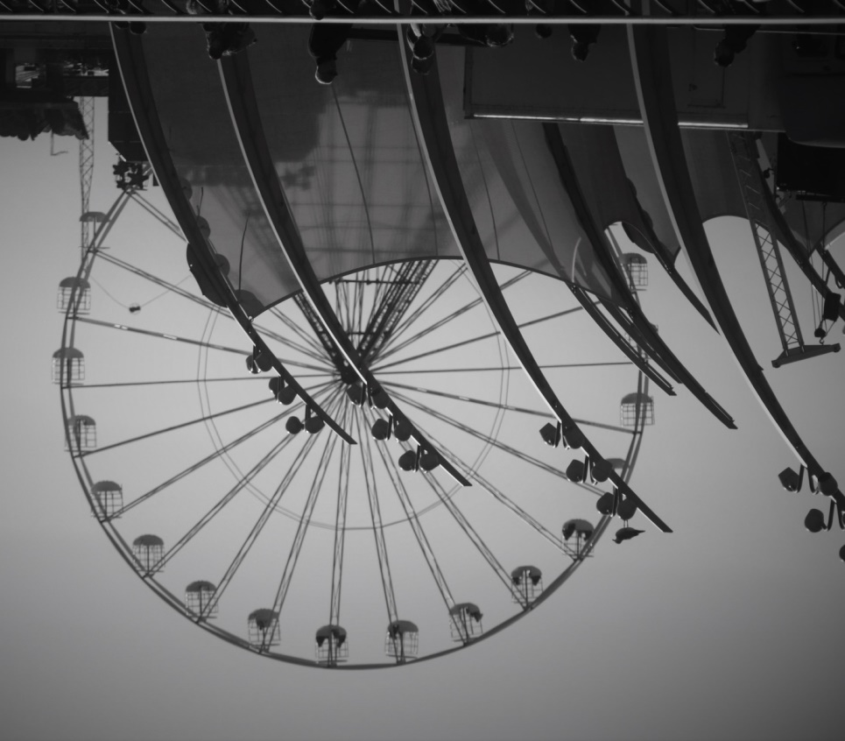
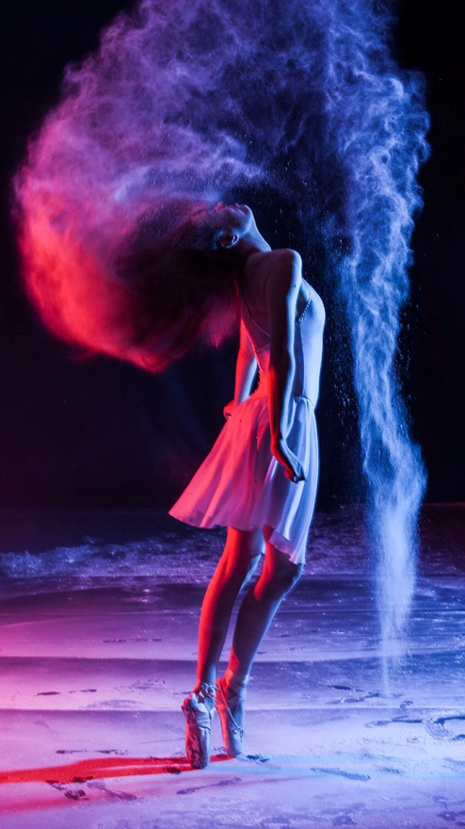
Theme Category
Movement – En Point,
Lucy Allan
Nothing is Ordinary – Wheelie Wong, Franciszek Bryszkiewski
Notes:
Themes ‘Nothing is Ordinary’ (Wheelie Wong) and ‘Movement’ (En Point)

Slide 15
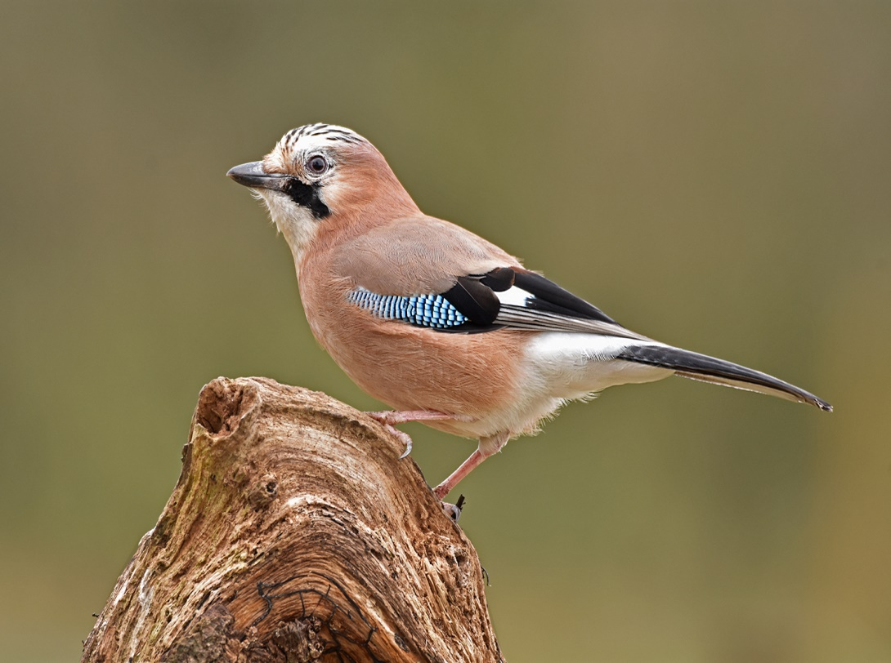
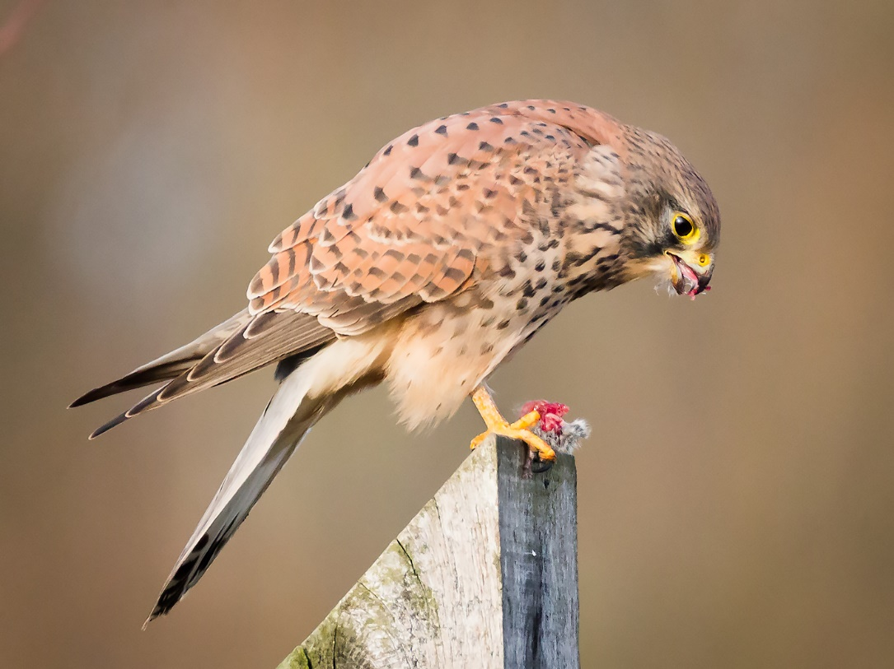
Flora & Fauna Category
Eurasian Jay Ian McGill
Kestrel with Vole Trevor Southward
Notes:
Flora and Fauna images are usually birds, bugs and bushes (Flowers)

Slide 16
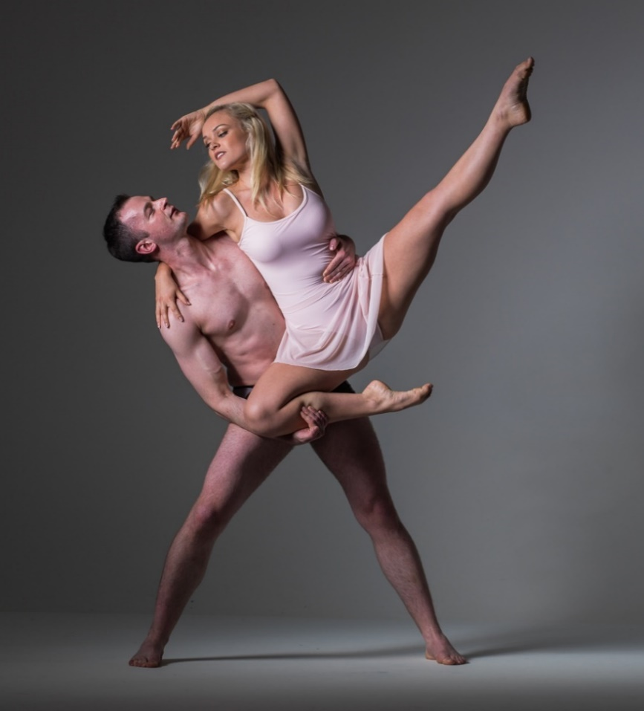
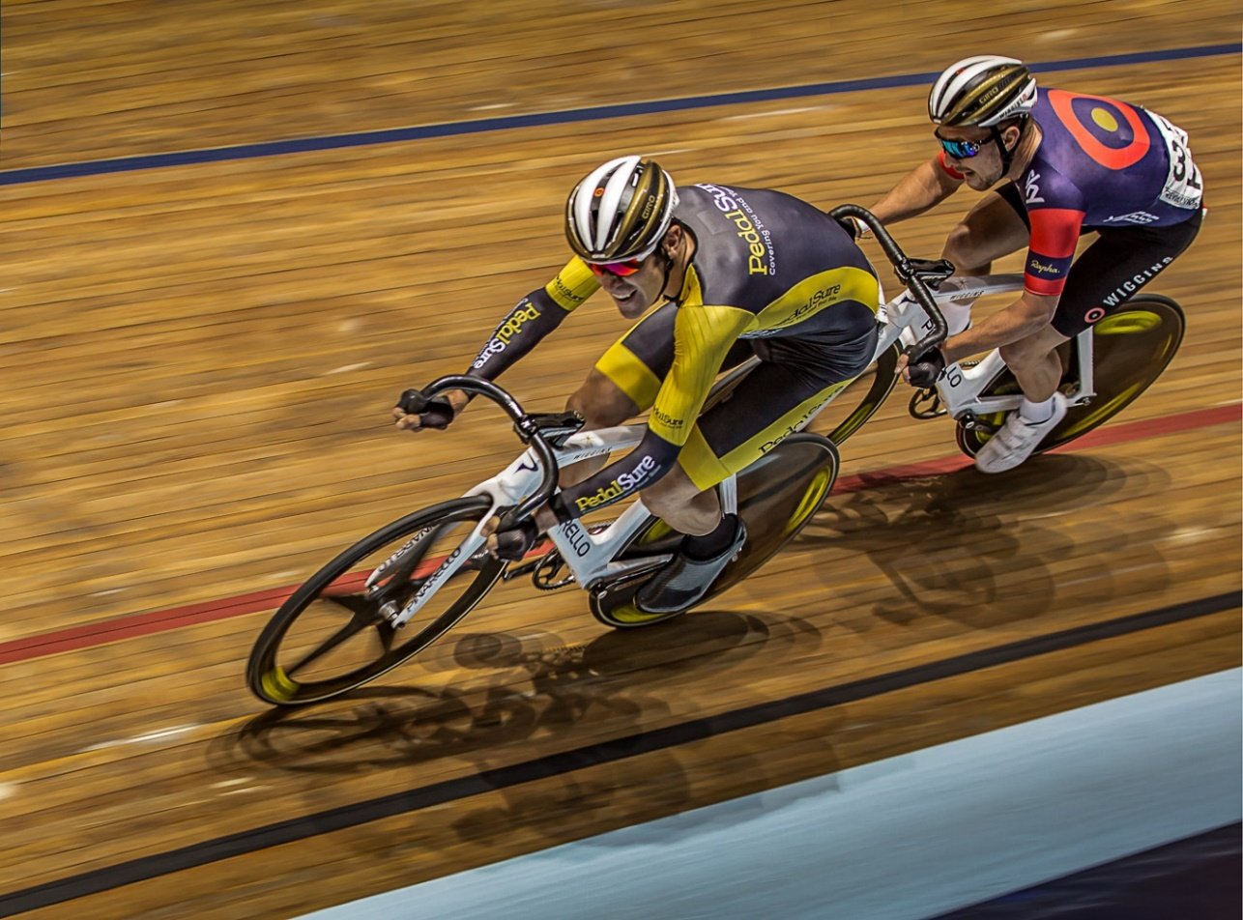
Advanced Category
The Lift Robert Turley
Coming Up On the Outside Michael Porter
Notes:
The picture on the right was from the Manchester Velodrome ( Olympic Gold Medal Winners).

Slide 17
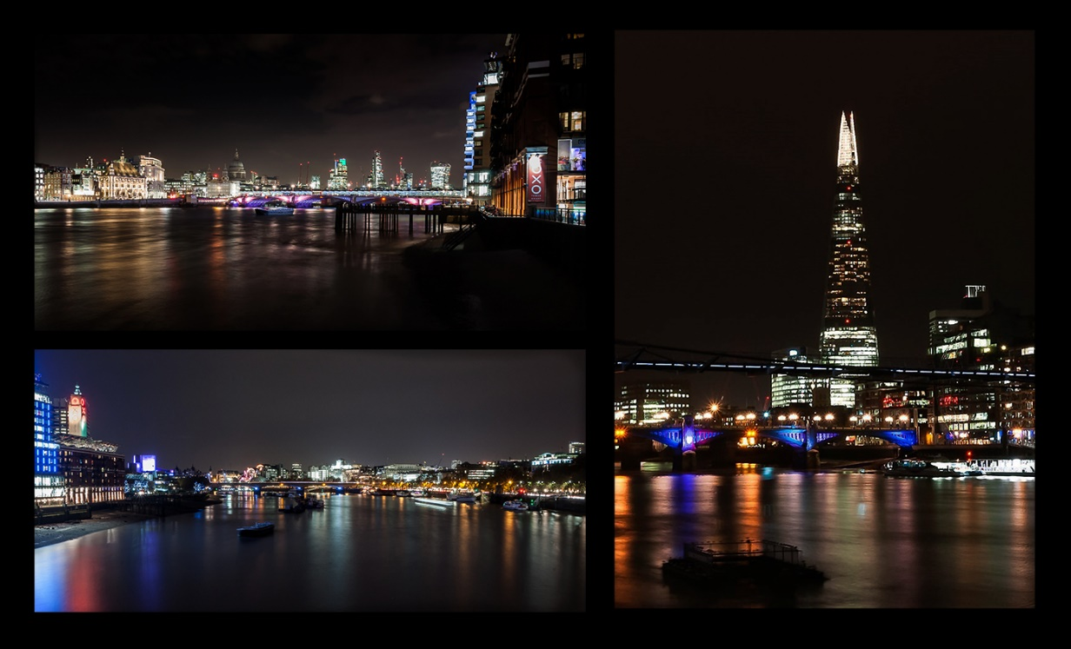
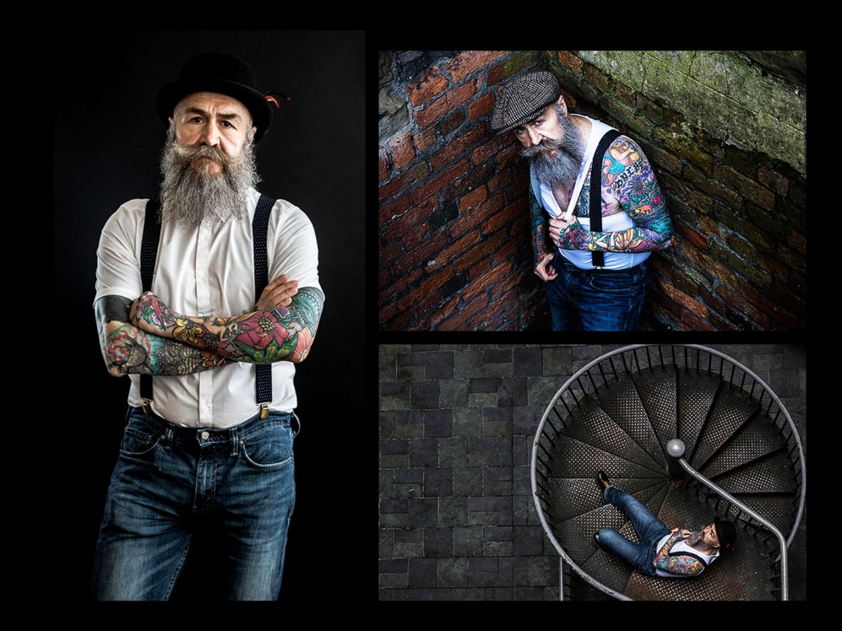
Three on a Theme Competition Images….
London at Night David Duxbury
Pip Helen Hatch

Slide 18
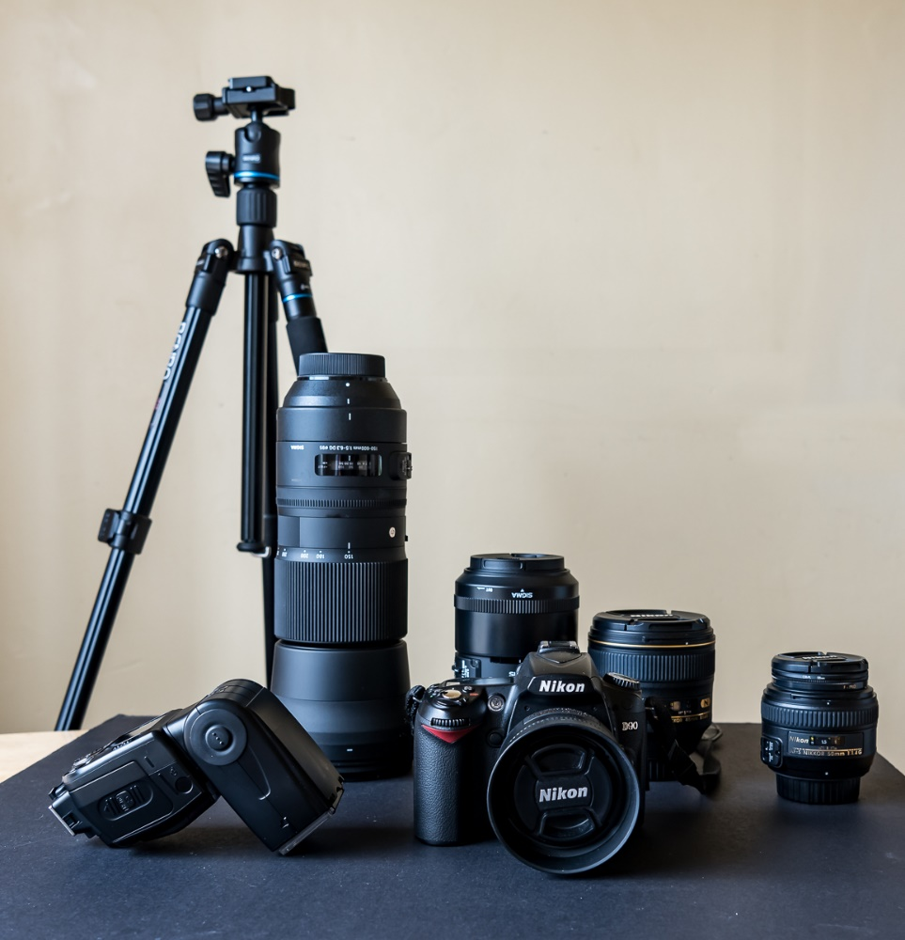
Equipment we use and Setup
The best camera is the one you have! You do not need expensive cameras, lenses and tripods to take good photographs. But, you need to know how to use them and their limitations when conditions are difficult.
Oh and you need a good eye for an interesting picture!!
This is some of the equipment we use:
Cameras: Bridge, DSLR, Mirrorless, Compact
Lenses: Macro, Prime, Zoom, Telephoto Tilt & Shift
Studio Lights, Light Boxes, Speed-lights
Tripods, Monopods
Filters ND, Polarizing
Reflectors
Computers & Application Software
Notes:
The best camera is the one in your hand!!
You don’t need expensive cameras / lenses, but you do need to know how to use them properly and also know their limitations.
You also need a good eye for a picture!
This is kit is : 600mm telephoto lens for wildlife, 105mm macro lens for insects/close-ups, 85mm & 50mm prime lenses for portraits and landscapes. Tripod, flash and reflector is used when natural light becomes poor. The camera happens to be a Nikon D90.

Slide 19
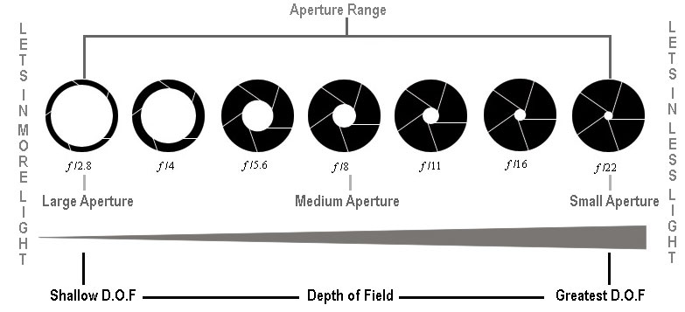
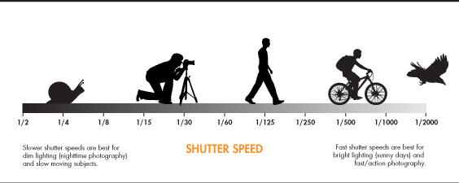
The things you need to set
There are only three basic things to control on your camera when you take a picture.
Aperture The amount of light the lens lets through (size of the hole or F stop). F2.8 (big hole) up to F22 (little hole). This also affects the amount of the image in focus (depth of field)
Speed How fast the camera shutter needs to be. 1/5000sec up to 30sec. This can affect how blurred your subject may be
ISO How sensitive you want the camera to be. ISO100 up to ISO12000. ISO100 for full daylight / ISO6000 at night, but this affects image quality.
But getting the balance right for the situation you are in is the tricky bit! This is where skill and experience is required, some of the other controls on the camera and other bits of equipment e.g. Flash, Tripod, Filters, Reflectors.
Notes:
There are only three controls on a camera that you can vary to get a good photo.
Aperture: the size of the hole in the lens that lets the light in. Called F-number. The smaller the number the bigger the hole.
This can also affect the depth of field in a picture the amount of clarity focus from front to back.
Speed: Shutter speed is how quickly the camera takes the picture. You can use a slow shutter speed to smooth out waves on water or a fast shutter speed to freeze motion and eliminate camera shake which can cause blur.
ISO: This is how sensitive the camera sensor is to light. Ideally the lower the sensitivity the better the quality of the image. Less noise. Typically ISO needs to be 100-200.
But getting the balance between these three variables is the tricky bit! This is where skill, training and experience come in supplemented by tripod, flash and reflectors where necessary.

Slide 20
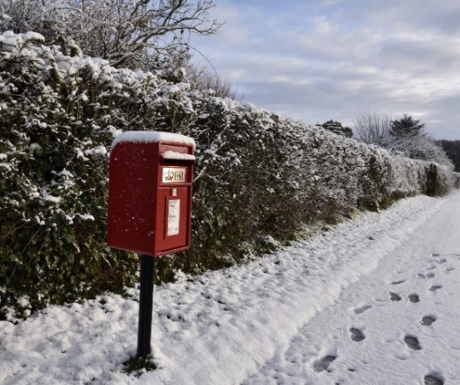
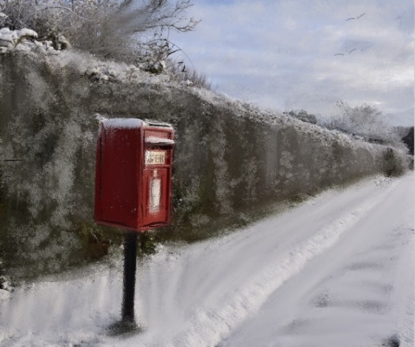
Post Processing / Editing……
You can download and edit pictures afterwards on a computer using Adobe Lightroom, Photoshop, Elements or other editing suites Nikon NX/DX, Cyberlink Photo Director, Portrait Pro. These allow you to modify the pictures you have taken. Make them lighter/darker, colours stronger, crop them to a size you want, change colours mask items out etc…..Then print them off!
Or you can also perform pixel art on them in Art Set to create a pastel images.
Notes:
To print or see the pictures, you first need to download them to a computer.
Image Processing can be done using software applications such as Adobe Lightroom or Photoshop or Elements or another suite like Cyberlink Photo Director or Nikon NX / DX (free!).
Modify the images to your taste then print them or store them on media. Images can also be sent to applications like Art Set to convert into a pastel picture for sending to your Mum or your other half for Christmas!

Slide 21
How To Join PPS
Download and complete an application form from the PPS website. Membership is normally £50 per year (£40 concessions). This equates to as little as £1.20 per evening if you attend every session with Photowalks thrown in. Payment can be made by Bank Transfer, Cheque or Cash (in that order of preference).
Parking is free! (but sometimes goes fast if the bowlers are playing). Tea / Coffee and Biscuits are available on the night (60p), or if you want to treat yourself there is a full bar!
Notes:
If you fancy having a go come along to the PPS on Thursday to see what it’s like, then download an application form from the PPS Web site and join if you want.

Slide 22
And Finally…
Thank you for coming to the Preston Photographic Society this evening and letting us introduce our club.
We hope you have enjoyed our presentation and if it has inspired you to go out and take more photographs, then we are happy.
If you want to become a member of the PPS, come along and see for yourself before you join. Our season started on Thursday, 5th September and although the club may be over 114 years old, it is not in spirit…..
Thank you. Any Questions?
Notes:
Finally I would like to thank you once again for coming along this evening and letting us introduce our club - PPS.
Thank you for your participation and a special thanks to the pressed volunteers, give them a round of applause.
If you have been inspired to take more photographs after our presentation, then we are happy.
If you do fancy coming to the PPS come along any Thursday at 7:30pm.
Any More Questions?

